Slide 1
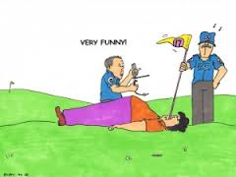
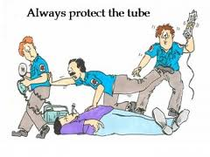
Rapid Sequence Intubation
Emergency Nursing Care
Lucy Vermeulen, Emergency Care

Slide 2
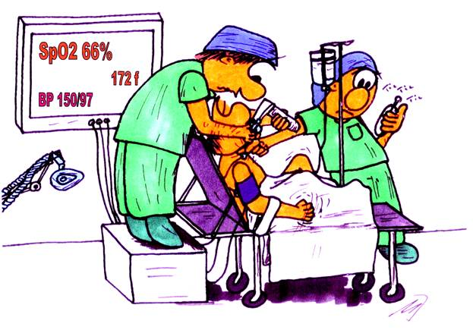
Rapid Sequence Intubation (RSI)

Slide 3
RSI is the preferred method of intubation
in the emergency because it induces
unconsciousness & paralysis while
managing airway patency and maximizing
hemodynamic stability (Lafferty, 2012)
Don’t confuse RSI with emergency
intubations in arrests.
Notes:
http://emedicine.medscape.com/article/80222-overview
Called RSI because the induction drug and neuromuscular blocking agent are administered in rapid succession with no time allowed for manual ventilation. In general anesthesia patient will be manually ventilated for a short period of time before a neuromuscular agent is administered and the patient is intubated

Slide 4
Indications for RSI
AIRWAY MANAGEMENT
FAILURE TO VENTILATE OR OXYGENATE
ANTICIPATED OUTCOMES
Notes:
http://www.ccmtutorials.com/rs/intubate/in_vent4.htm

Slide 5
Factors Making Intubation Difficult
Dynamically deteriorating clinical situation, i.e., there is a real “need for speed”
Non-cooperative patient
Respiratory and ventilatory compromise
Impaired oxygenation
Full stomach (increased risk of regurgitation, vomiting, aspiration)
Extremely short safe apnea times
Secretions, blood, vomitus, and distorted anatomy
LIFL, 2014

Slide 6
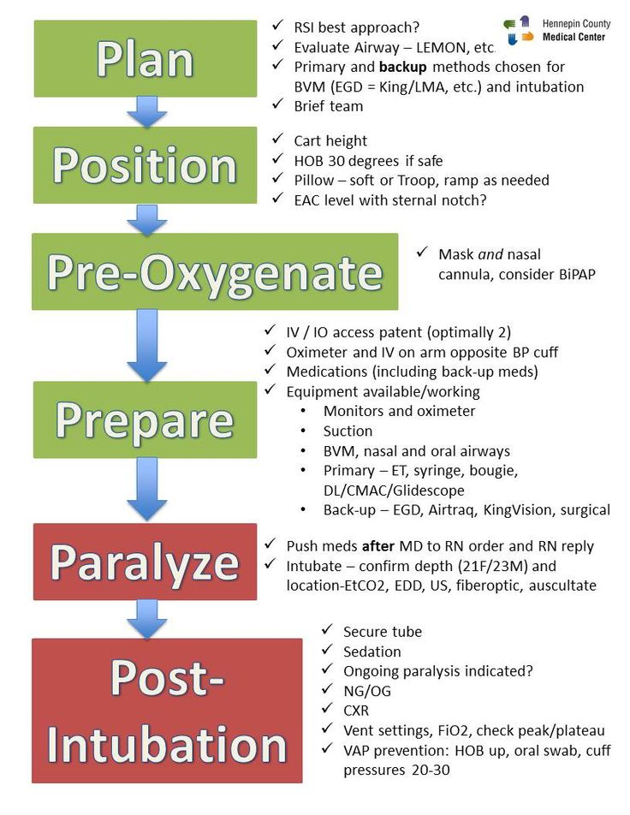
Notes:
L – Look externally
E – evaluate mobility of mouth
M- Mallampati classification (can structures be visualized)
O- obstruction?
N – neck mobile?
EAC = external auditory canal

Slide 7
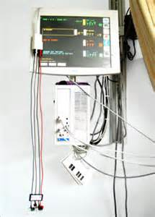
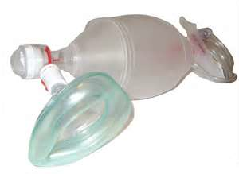
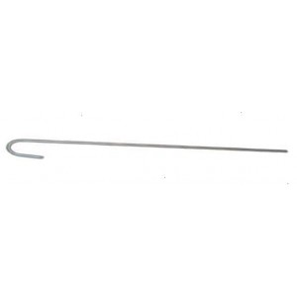
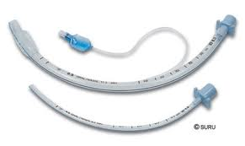
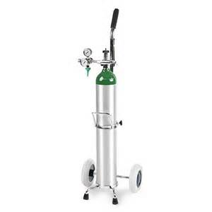
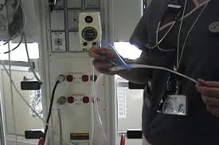
Required Equipment
intubation
stylet
monitor:
cardiac,
BP, O2 sat
Bag valve mask
BVM
ET tube
source
of
oxygen
Suction set up

Slide 8
Preparation
Ensure patent IV access
Gather essential equipment: BVM, ET tube,
laryngoscope, stylet, suction, oxygen
Ensure appropriate personnel: ED MD
is present, RN(s), Respiratory Therapist
Ensure patient is on continuous monitor:
ECG, O2 saturation, recent BP obtained
Ensure patient is supine/semi fowlers

Slide 9
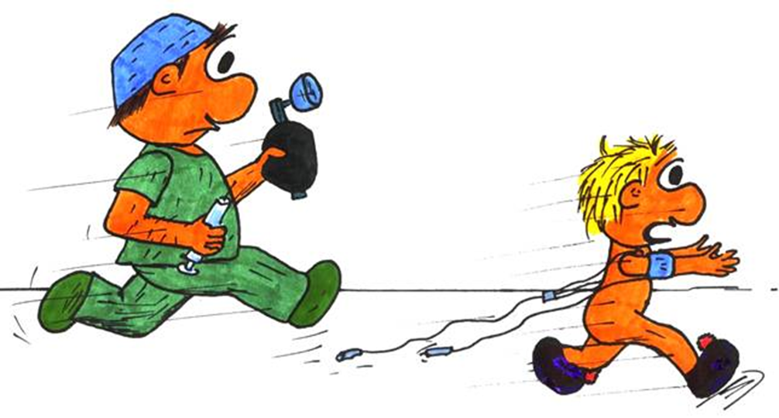
Pre-Oxygenate
Pre-oxygenate with 100% oxygen using
NRB or BVM. Consider using mask AND N.C.

Slide 10
Pre-Medicate
Pre-medication may be important because the manipulation of the airway can cause a sympathetic response leading to an increase in blood pressure, pulse and intracranial pressure.

Slide 11
Pre-treatment: Medications
Protective agents: medications given
to minimize intubation effects. Use is not
standard and supporting literature is mixed.
For example:
Lidocaine: increased intracranial pressure
Atropine: bradycardia

Slide 12
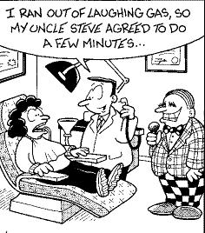
Pre-Treatment
Induction Agents

Slide 13
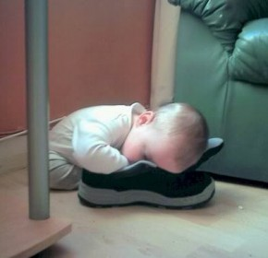



Induction agent: “a rapidly acting
sedative”

Slide 14

Induction agents
Sedative/Analgesics
Pre-treat awake patient with a sedating agent.
Imagine being paralyzed and wide awake! Paralytics do not provide sedation,
analgesia, or amnesia; therefore, premedication
is critical to successful RSI

Slide 15
RSI – Sedatives/Analgesics
Ketamine: Anesthetic; analgesic,
sedative, amnestic;
Concentration of IV infusion: | 500 mg/50 mL (10 mg/mL)
Dose: | Induction: 1 - 2 mg/kg, as a single dose over 30 - 60 seconds. Maintenance: 0.3 - 1.2 mg/kg/hour as a continuous infusion
Notes:
Also has bronchodilatory effects: great for COPD, asthmaticus
Ketamine: Ok for mild hypotension or hypovolemia;
may increase ICP: positive/negative
effects depending on patient;

Slide 16
Ketamine
Route of administration: | IV Direct (MD at bedside) slowly over 1 min; IV Infusion
Mechanism of action: | Stimulates receptors at the GABA complex, causing anesthesia; excites opioid receptors producing analgesia; stimulates catecholamine. Minimizes vasodilatory effect. Maintains respiratory drive.

Slide 17
Ketamine
Side Effects: | Tachycardia, hypertension, increased salivation
Contraindications: | Symptomatic hypertension
Cautions: | Use cautiously in patients with inc. ICP
Monitoring: | ECG/BP q5 during procedure then q15; monitor for confusion, hallucinations,
http://www.uptodate.com/contents/sedation-or-induction-agents-for-rapid-sequence-intubation-in-adults

Slide 18
Propofol
Classification: | Anesthetic, Sedative
Concentration of IV infusion: | 1000 mg in 100 mL (10 mg/mL)
Dose: | Initial infusion: 0.3-0.6 mg/kg/hour every 5 to 10 minutes. May increase risk of hypotension
Notes:
Propofol: Cardiac depression;
If normotensive & HI or status epilepticus

Slide 19
Propofol
Mechanism of action: | Causes global CNS depression
Used for: | Procedural sedation; induce anesthesia
Side Effects: | Hypotension, bradycardia, myocardial depression, flushing

Slide 20
Midazolam
Classification: | Anxiolytic, sedative
Concentration: | 1 mg/mL
Dose: | 0.15 - 0.6 mg/kg . May repeat at 10- to 15-minute intervals .
Route: | IV Direct
Mechanism of action: | A short-acting CNS depressant
Side Effects: | Hypotension, bradycardia, drowsiness, amnesia, respiratory depression
Notes:
Midazolam: prolonged onset of action; often
under-dosed d/t risk of hypotensio

Slide 21
Fentanyl
Classification: | Narcotic analgesic
Concentration: | 50 mcg/mL
Dose: | IV Direct: Acute pain: 10 - 25 mcg, titrate every 6 - 10 minutes until analgesia achieved.
Notes:
Fentanyl: blunts sympathetic response (counteracts
increases in HR, pulse)

Slide 22
Fentanyl
Side Effects: | Hypotension, bradycardia, CNS depression, respiratory depression, muscle rigidity
Contraindications: | Acute respiratory depression, acute asthmatic attack and upper airway obstruction

Slide 23
Pre-treatment
Neuromuscular Blockers

Slide 24
Neuromuscular blockers: a group of drugs that prevents motor nerve endings from exciting skeletal muscle; used produce paralysis and facilitate manipulation of muscles.
Notes:
fasciculation

Slide 25
Neuromuscular Blockade
Depolarizing Agents
Succinylcholine
Stimulates all cholinergic
receptors throughout the
parasympathetic and
sympathetic nervous
systems. By binding to Ach
receptors, Sux produces stimulation leading to temporary fasciculations leading to paralysis
Non-depolarizing Agents
Rocuronium
competitively inhibit the
postsynaptic ACh receptors
of the neuromuscular motor
endplate. This action
prevents depolarization and
inhibits all muscular function.
Notes:
Neuromuscular blocking agents are classified by their mechanism of action

Slide 26
Succinylcholine (Sux)
Classification: | Neuromuscular blocker
Dose: | 0.3-1.5 mg/kg undiluted
Route of administration: | IV Direct (MD)
Mechanism of action: | Complex interaction caused by the desensitization of the receptor and the inactivation of the sodium channels

Slide 27
Succinylcholine (Sux)
Side Effects: | May be associated with malignant hyperthermia; increased intraocular pressure; May increase vagal tone.
Contraindications: | (Family) Hx of malignant hyperthermia; acute burn/trauma; spinal cord damage, CVA
Cautions: | fasciculations occur a few seconds injection; can cause muscle damage. Use with caution in patients with pre-existing hyperkalemia.
Notes:
Rapid onset, short duration,(3-5 mins)
in fridge

Slide 28
Rocuronium
Classification: | Neuromuscular blocking agent
Dose: | Initially, 0.6 - 1.2 mg/kg. maximum bolus dose is 100 mg
Route: | IV direct
Mechanism of action: | Causes skeletal muscle relaxation primarily by causing a decreased response to the neurotransmitter acetylcholine at the neuromuscular junction of skeletal muscle.
Notes:
Intubate 45 seconds after paralytic; if oxygen saturation is inadequate, stop laryngoscopy and ventilate with bag-mask
Tube depth is (12 + age in years/2), up to 20-22 cm in adult women and 22-24 cm in adult men

Slide 29
Rocuronium
Side Effects: | Hypotension, hypertension, arrhythmias, tachycardia, bronchospasm
Cautions: | Has no analgesic or sedative properties; patients also require continuous analgesic and sedative administration.
Notes:
Premixed in fridge
Min cardiovascular effects
rapid onset, duration 30-60 min
Contraindicated with
head/eye trauma & CV disease

Slide 30
Cisatracurium
Classification: | Neuromuscular blocking agent
Dose: | IV/IO push: 0.1 mg/kg
Route of administration: | IV direct
Mechanism of action: | It competitively binds to acetylcholine receptors preventing neuromuscular transmission.
Notes:
Onset: 3-5 minutes
Duration: 60-90 minutes
Side effects: Minimal cardiovascular effects
bradycardia or tachycardia
hypertension or hypotension
bronchospasm
anaphylaxis
hypothermia
corneal ulceration
excessive salivation

Slide 31
Cisatracurium
Side Effects: | Bradycardia, hypotension, and flushing resulting from histamine release, bronchospasm, laryngospasm, rash and pruritus
Cautions: | Has no analgesic or sedative properties; patients also require continuous analgesic and sedative administration.

Slide 32
Intubation
Intubate 45 seconds after paralytic
If oxygen saturation is inadequate, stop laryngoscopy and ventilate with bag-mask
Tube depth is (12 + age in years/2), up to 20-22 cm in adult women and 22-24 cm in adult men
Lamberg, 2014

Slide 33
Post RSI Care
Secure end-tidal CO2 monitor.
Ensure proper ET placement: CXR.
Ongoing continuous monitoring & documentation.
Ongoing sedation, paralytics as needed.
Anticipate ventilator or transfer to ICU/CCTC/PCCU.

Slide 34
End-tidal CO2
End tidal CO2 monitoring is used to monitor CPR quality, optimize chest compressions and detect return of spontaneous circulation (ROSC) during cardiac arrest

Slide 35
End-tidal co2
CO2 <10mm Hg indicative of ineffective CPR
Push harder or faster or change provider
During CPR goal is to measure CO2 of 10-15mm HG
Abrupt increase of CO2 to 35-40mm HG can be indicative of ROSC

Slide 36
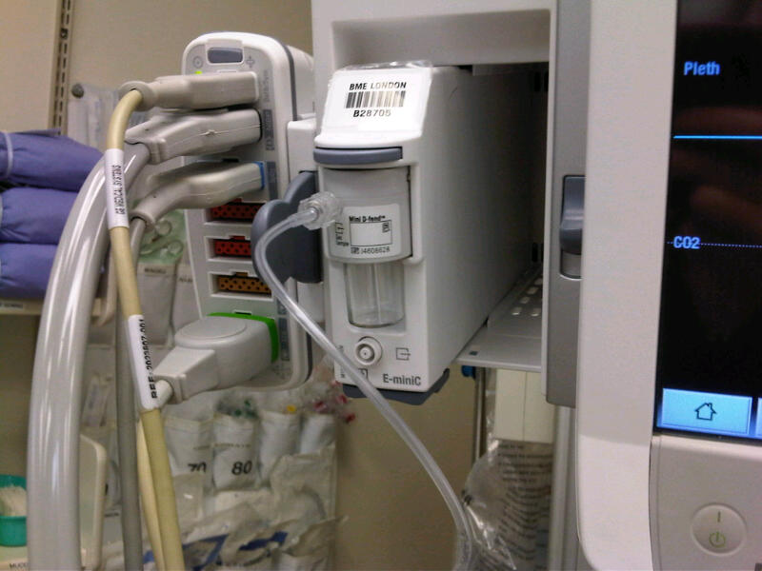
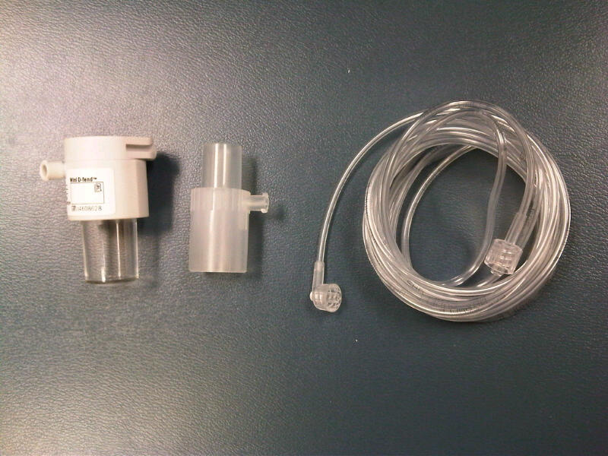
Required equipment
CO2 module plugs into monitor
Water trap / T-connector / gas line

Slide 37
References
Lafferty, K.A. (2012). Rapid Sequence Intubation. Retrieved April 26, 2013 from
http://emedicine.medscape.com/article/80222-overview
Lamberg, J. (2014) ACLS: Rapid Sequence Induction and Intubation. Retrieved April
28, 2015 from http://emedicine.medscape.com/article/2172130-overview
http://emedicine.medscape.com/article/2172130-overview
Life in the Fast Lane (2014). Rapid Sequence Intubation. Retrieved April 22, 2015
from http://lifeinthefastlane.com/ccc/rapid-sequence-intubation/

